Slide 1

Geometry
Unit 1, Lesson 2 Defined and Undefined Terms – Part 2 Volume 1, pg. 9

Slide 2


Benchmarks
MA.912.GR.1.1
Prove relationships and theorems about lines and angles. Solve mathematical and real-world problems involving postulates, relationships, and theorems of lines and angles.
MA.912.GR.2.2
Identify transformations that do or do not preserve distance.
volume 1, pg. 9

Slide 3
Integrated Mathematical Thinking and Reasoning Standards
MA.K12.MTR.1.1 Actively participate in effortful learning both individually and collectively.
MA.K12.MTR.2.1 Demonstrate understanding by representing problems in multiple ways.
MA.K12.MTR.4.1 Engage in discussions that reflect on the mathematical thinking of self and others.
volume 1, pg. 9

Slide 4

Learning Targets
I can understand the three undefined terms of geometry.
I can use rigid motions to define a straight angle.
I can experiment with rigid motions on a plane.
volume 1, pg. 9

Slide 5

Warm-Up
volume 1, pg. 10

Slide 6
1.2.1 Warm-Up: Would You Rather?
Would you rather have pennies to match your weight or quarters to match your height?
Explain your reasoning.
volume 1, pg. 10

Slide 7

Exploration
volume 1, pg. 10

Slide 8

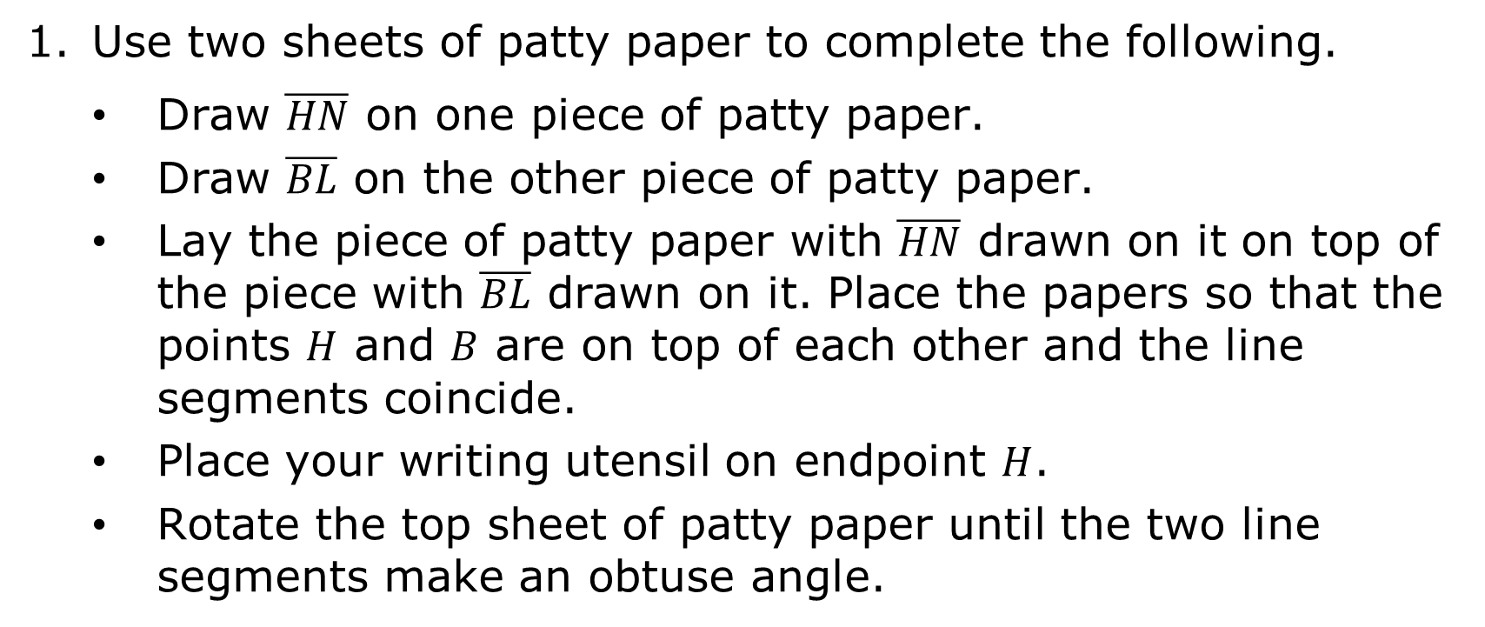
1.2.2 Exploration: Definitions
Use two sheets of patty paper to complete the following.
Draw $\overline{HN}$ on one piece of patty paper.
Draw $\overline{BL}$ on the other piece of patty paper.
Lay the piece of patty paper with $\overline{HN}$ drawn on it on top of the piece with $\overline{BL}$ drawn on it. Place the papers so that the points $H$ and $B$ are on top of each other and the line segments coincide.
Place your writing utensil on endpoint $H$.
Rotate the top sheet of patty paper until the two line segments make an obtuse angle.
volume 1, pg. 10

Slide 9
Draw the obtuse angle you created below.
When you rotated the top sheet, did the line segment change in size?
When you rotated the top sheet, did the line segment change in position?
volume 1, pg. 10

Slide 10
Which part(s) of the obtuse angle has two points?
Rotate the top sheet of patty paper until the two line segments make a straight line.
Name the resulting line segment using the endpoints.
volume 1, pg. 11

Slide 11

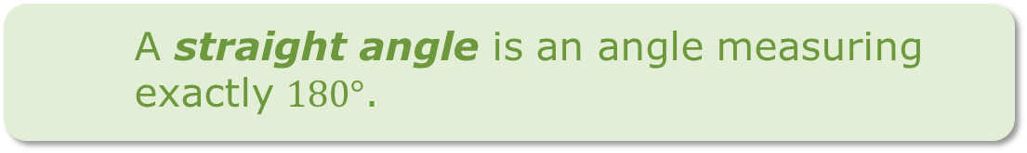

Work with your partner to estimate the number of degrees you rotated the top sheet of patty paper from its original position on top of line segment $BL$.
Based on the rotation and the definition of a straight angle, what “fact” about a line can be added to the “Facts about Lines” in the previous lesson?
A straight angle is an angle measuring exactly $180°$.
volume 1, pg. 11

Slide 12

Bring It Together
volume 1, pg. 11

Slide 13


1.2.3 Bring It Together: Undefined Terms
A definition is an exact statement, written formally, of the meaning or description of a word.
There are three terms in geometry that are considered “undefined terms.”
A term is considered undefined if, when explaining the term, the explanation relies on the term itself or a close synonym. This is sometimes called a circular definition.
volume 1, pg. 11

Slide 14
In the previous lesson you wrote a definition for the term “line.” Review your definition and determine if your definition is considered circular.
Although we have “facts about lines,” “line” is an undefined term in geometry. The other two undefined terms in geometry are “point” and “plane.” Look back through the previous lesson to notice how often these terms were used without providing a definition.
volume 1, pg. 11

Slide 15
Work with your partner to label each description as a line, plane, or point.
Description | Undefined Term
has two dimensions | Line Point Plane
has no length, no width, and no height | Line Point Plane
is often drawn as a four-sided figure | Line Point Plane
has infinite length, no width, no height | Line Point Plane
volume 1, pg. 12

Slide 16
Description | Undefined Term
named by an ordered pair in the coordinate plane | Line Point Plane
indicates a location or position | Line Point Plane
has one dimension | Line Point Plane
has infinite length, infinite width, and zero height | Line Point Plane
has no dimension or actual size | Line Point Plane
volume 1, pg. 12

Slide 17

Wrap-Up
volume 1, pg. 12

Slide 18
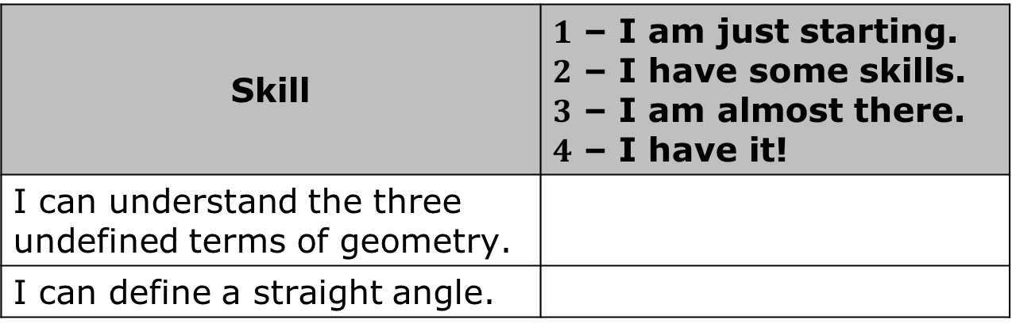
1.2.4 Wrap-Up: Reflection
Rate yourself based on what you understood in today’s lesson.
Skill | $1$ – I am just starting. $2$ – I have some skills. $3$ – I am almost there. $4$ – I have it!
I can understand the three undefined terms of geometry.
I can define a straight angle.
volume 1, pg. 12

Slide 19
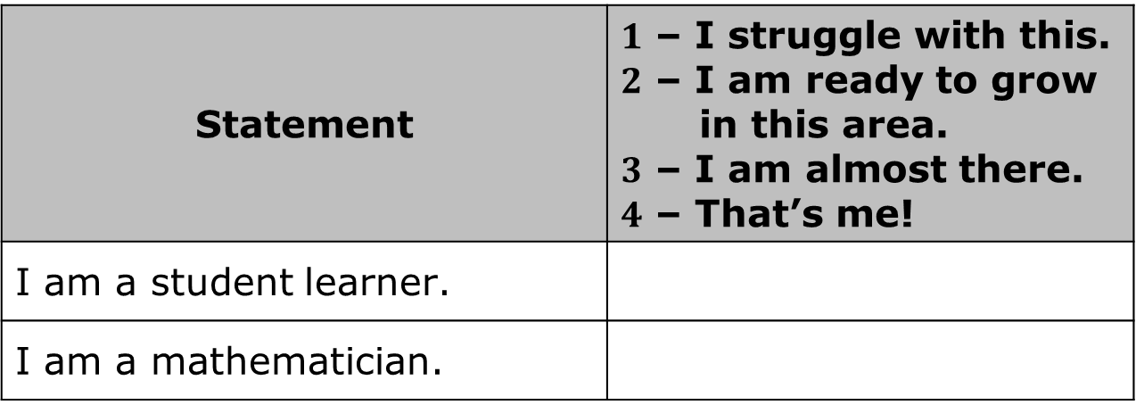
Rate yourself based on how you feel about the following statements.
Statement | $1$ – I struggle with this. $2$ – I am ready to grow in this area. $3$ – I am almost there. $4$ – That’s me!
I am a student learner.
I am a mathematician.
volume 1, pg. 12

